Slide 1
FERTILIZERS RECOMMENDATION SYSTEM FOR DISEASE PREDICTION
Team ID:
PNT2022TMID22999
Team Leader:
Harshini. T
Team Members:
Divya Sri.N
Paarkavi Priya. S
Kharshitha Bhuvani. E
Facutly Mentor:
Dr. R. Vijayalakshmi, B.E, M.E, Ph.D.
Department of Computer Science & Engineering
Velammal College of Engineering and Technology

Slide 2
Project Description
Agriculture is the most important sector in today’s life. Most plants are affected by a wide variety of bacterial and fungal diseases
Hence, early and accurate identification of plant diseases is essential to ensure high quantity and best quality
In recent years, the number of diseases on plants and the degree of harm caused has increased due to the variation in pathogen varieties, changes in cultivation methods, and inadequate plant protection techniques
An automated system is introduced to identify different diseases on plants by checking the symptoms shown on the leaves of the plant
Deep learning techniques are used to identify the diseases and suggest the precautions that can be taken for those diseases
Department of Computer Science & Engineering
Velammal College of Engineering and Technology

Slide 3
Survey Paper-1
Author – Limin Chuan, Ping Hea
Title – Estimating Nutrient update requirements for wheat in China
Established By - IEEE
Published Time – January 2013
Objectives - Two parameters namely yield response and agronomic efficiency are used by the recommendation system. It also considers the Nitrogen, Phosphorous, and Potassium (NPK) contents for fertilizer recommendation of wheat. It helps to prevent the inappropriate application of fertilizers in wheat production systems in China.
Department of Computer Science & Engineering
Velammal College of Engineering and Technology

Slide 4
Survey Paper-2
Author - Hao Zhang, Li Zhang, Yanna Ren, Juan Zhang, Xin Xu, Xinming Ma, Zhongmin Lu
Title – Design and implementation of crop recommendation fertilization decision system based on WEBGIS at village scale
Established By – IEEE
Published Time –March 2015
Objectives – It is specifically developed for villages in China. Maps of villages are taken and location-specific recommendations are provided using ArcView in ArcGIS. Three parameters are considered for recommendations namely soil measurements, farm production level, and target yield for the crop.
Department of Computer Science & Engineering
Velammal College of Engineering and Technology

Slide 5
Survey Paper-3
Author - Mansi Shinde1, Kimaya Ekbote, Sonali Ghorpade, Sanket Pawar, Shubhada Mone
Title – Crop recommendation and fertilizer purchase system
Established By – International Journal of Computer Science and Information Technologies
Published Time – December 2017
Objectives - Recommendations for purchasing fertilizers from an online portal based on the history of past purchases. Apriori algorithm is used for this purpose. Apriori algorithm is a sequence of steps to be followed to find the most frequent itemset in the given database.
Department of Computer Science & Engineering
Velammal College of Engineering and Technology

Slide 6
Survey Paper-4
Author - Zhimin Liu, Weidong Xiong, Xuewei Cao
Title - Design of Precision Fertilization Management Information System on GPS and GIS Technologies
Established By – IEEE
Published Time – March 2019
Objectives - Recommendations are done by applying data mining techniques to information collected by GIS and GPS. Precision Fertilization Management Information System (PFMIS) is a fertilization recommendation system based on GIS and GPS. ArcGIS is used for maps on soil resources
Department of Computer Science & Engineering
Velammal College of Engineering and Technology

Slide 7
Survey Paper-5
Author – Kiran Shinde, Jerrin Andrei, Amey Oke
Title - Web Based Recommendation System for Farmers
Established By – International Journal on Recent and Innovation Trends in Computing and Communication
Published Time – November 2019
Objectives - For crop recommendations, they have used market trends data and applied a random forest algorithm to that. They have developed a web-based recommendation system for crop and fertilizers recommendation by considering past data about market prices.
Department of Computer Science & Engineering
Velammal College of Engineering and Technology

Slide 8
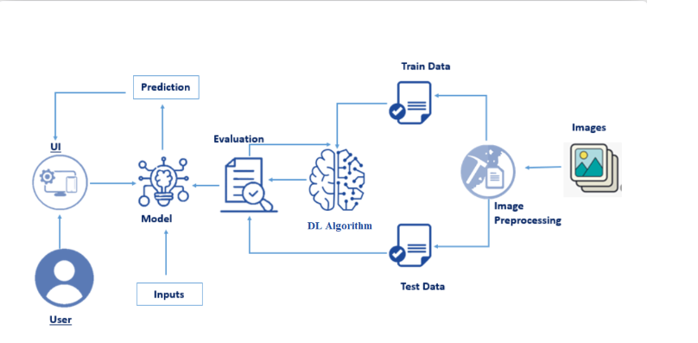
TECHNICAL ARCHITECTURE
Department of Computer Science & Engineering
Velammal College of Engineering and Technology

Slide 9
Thank You!
Department of Computer Science & Engineering
Velammal College of Engineering and Technology

